Slide 1



Front end applications
By Elham Jaffar

Slide 2
api

Slide 3
API
What does API stand for?
Application
Programming
Interface
APIs are sets of requirements that govern how one application can talk to another. It is usually used by establishing a reference to a library in your software or importing a function.

Slide 4



API in real life
Menu and Order
Waiter
Kitchen

Slide 5
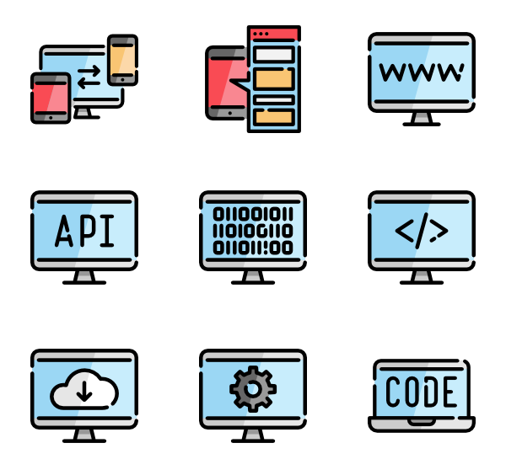
Advantages of using API
Automation: with APIs, computers rather than people can manage the work.
Application: because APIs can access the app components, the delivery of services and information is more flexible.
Efficiency: It allows it to be shared and distributed more easily.
Integration: APIs allow content to be embedded from any site or application more easily.
Adaptation: needs change over time and APIs help to anticipate changes.

Slide 6
Cross-Origin Resource Sharing
The same-origin policy is an important security concept implemented by web browsers to prevent JavaScript code from making requests against a different origin (e.g., different domain) than the one from which it was served.
ERROR : Cross-Origin Request Blocked:
This can be fixed by enabling the CORS.:
Use (dataType: "jsonp”) with the $.ajax() // Tell jQuery we're expecting JSONP (callback)
Use $.getJSON() for encoded data.

Slide 7
Fetch api
The Fetch API provides a JavaScript interface for accessing and manipulating parts of the HTTP pipeline, such as requests and responses. It also provides a global fetch() method that provides an easy, logical way to fetch resources asynchronously across the network.

Slide 8
Fetch vs jQuery ajax
The fetch specification differs from jQuery.ajax() in two main ways:
The Promise returned from fetch() won’t reject on HTTP error status even if the response is an HTTP 404 or 500. Instead, it will resolve normally (with ok status set to false), and it will only reject on network failure or if anything prevented the request from completing.
By default, fetch won't send or receive any cookies from the server, resulting in unauthenticated requests if the site relies on maintaining a user session (to send cookies, the credentials init option must be set).

Slide 9
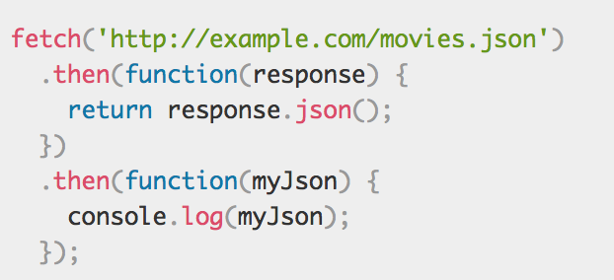
Basic fetch
Fetch returns a promise Object !
With response you still need to read json object

Slide 10
Flicker API
Let’s Code Together !
Create three files:
script.js
index.html
Add jQuery library to the directory
Can you do it with Fetch?

Slide 11
mvvm

Slide 12
MVVM
What does MVVM stand for?
Model
View
ViewModel
It’s a pattern that provides a clean separation between the UI and the rest of the application.

Slide 13
MVVM Components
This pattern is also called:
Model View Octopus, Model View Controller, Model View Presenter … etc.
Model
Octopus
View
Store data in a server including the user input
Connect View and Model
User Interface and page rendering

Slide 14
Why should you use mvvm?
Well-structured and understandable.
More flexibility to change user interface or data without refactoring other logic in the code base.
Reusable components.
Single page Application Vs Multipage Application

Slide 15




MVVM Frameworks
Ember
Angular
React
Vue.js

Slide 16
Why MVVM Frameworks?
By using the Front End frameworks, you can build your application according to a specific pattern which makes your code more organized.
Each framework has minor differences! Some of them offer more functionalities than the others.

Slide 17
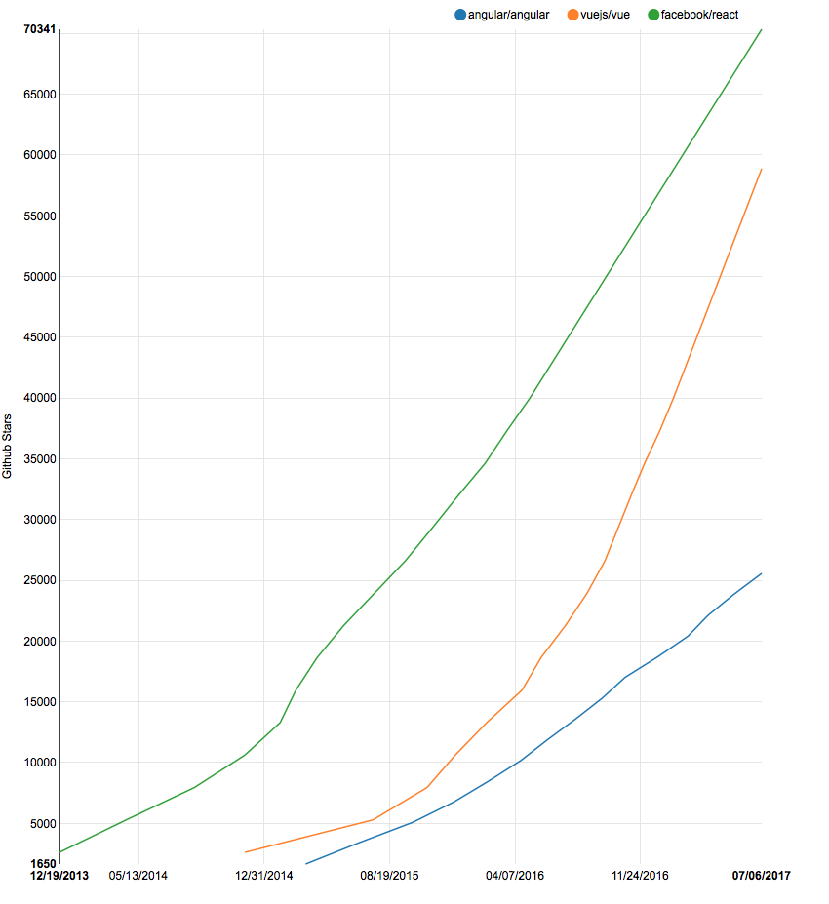
Angular vs react vs vue.js
For More Info !
Even More !
Notes:
https://medium.com/unicorn-supplies/angular-vs-react-vs-vue-a-2017-comparison-c5c52d620176

Slide 18
Angular?
Angular
Notes:
https://www.youtube.com/watch?v=BTF5WrKj2mY

Slide 19
Offline first & service Worker

Slide 20
Offline First
Objective:
Build an Application that works fine with connectivity issues & when the user offline.
Let’s understand the problem first!

Slide 21
Problems !
1- Lie-fi
When your phone or tablet indicates that you are connected to a wireless network, however you are still unable to load webpages or use any internet services with your device
Person 1: Can you get any wi-fi here? Person 2: No, it says I'm connected but it's really just lie-fi

Slide 22
How to solve it?
By using some kinds of caches which is called Offline first approach.
Offline first is an approach to software development in which developers build an application's core features to function with or without an internet connection.

Slide 23
Service Worker?
service worker is a script that your browser runs in the background, separate from a web page, opening the door to features that don't need a web page or user interaction.

Slide 24
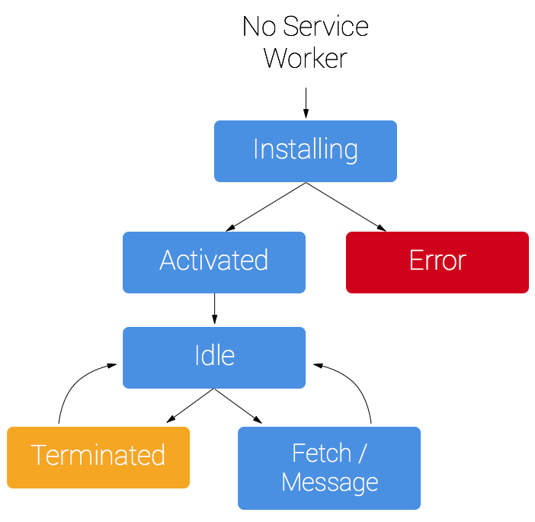
service worker lifecycle

Slide 25
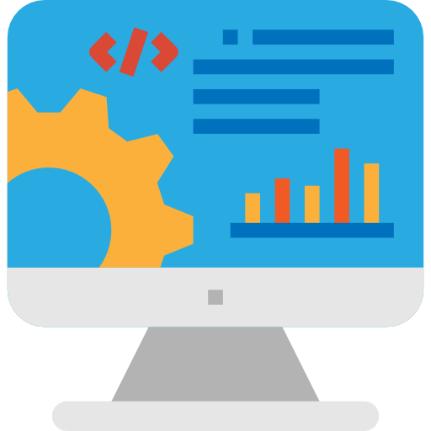



Service Worker

Slide 26
Run a server
During development you'll be able to use service worker through localhost, but to deploy it on a site you'll need to have HTTPS setup on your server.
Python 2: python -m SimpleHTTPServer 8000 Python 3: python3 -m http.server 8000

Slide 27
Register A service worker
if ('serviceWorker' in navigator) { window.addEventListener('load', function() { navigator.serviceWorker.register('/sw.js').then(function(registration) { // Registration was successful console.log('ServiceWorker registration successful with scope: ', registration.scope); }, function(err) { // registration failed :( console.log('ServiceWorker registration failed: ', err); }); }); }

Slide 28
Install a service worker
self.addEventListener('install', function(event) { // Perform install steps });
Inside of our install callback, we need to take the following steps:
Open a cache.
Cache our files.
Confirm whether all the required assets are cached or not.
For More Info !
Notes:
https://developers.google.com/web/fundamentals/primers/service-workers/

Slide 29
Cache and return requests
self.addEventListener('fetch', function(event) { event.respondWith( caches.match(event.request) .then(function(response) { // Cache hit - return response if (response) { return response; } return fetch(event.request); } ) ); });

Slide 30
Update a service worker
self.addEventListener('activate', function(event) { var cacheWhitelist = ['pages-cache-v1', 'blog-posts-cache-v1']; event.waitUntil( caches.keys().then(function(cacheNames) { return Promise.all( cacheNames.map(function(cacheName) { if (cacheWhitelist.indexOf(cacheName) === -1) { return caches.delete(cacheName); } }) ); }) ); });
Notes:
https://developers.google.com/web/fundamentals/primers/service-workers/

Slide 31
Exercise
Adding a Service Worker and Offline into your Web App
https://codelabs.developers.google.com/codelabs/offline/#0

Slide 32

Remember that we are here to help you
All you have to do is ASK!
Thank you for Attending

